Slide 1

> SPONSORING brochure
Pass the SALT 2019
second edition
sponsoring@pass-the-salt.org

Slide 2

The conference
Pass the SALT is a technical conference given in english and dedicated to Security and Free Software/Hardware.
The first edition has took place in Lille from July 2 to 4, 2018 and hosted 28 talks and 5 workshops.
The 2019 edition will be :
Date : July, 1-3 2019
Location : Lille, Polytech high school
Entrance : free
Attendance : 250 people

Slide 3
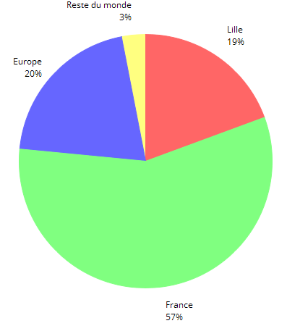
Attendance
« Pass the SALT » attendance is composed of a majority of hackers, security profesionals, students and researchers.
2018 attendees:
Origin:
215 registered people
the 2018 post event survey is available:
https://2018.pass-the-salt.org/feedback/

Slide 4
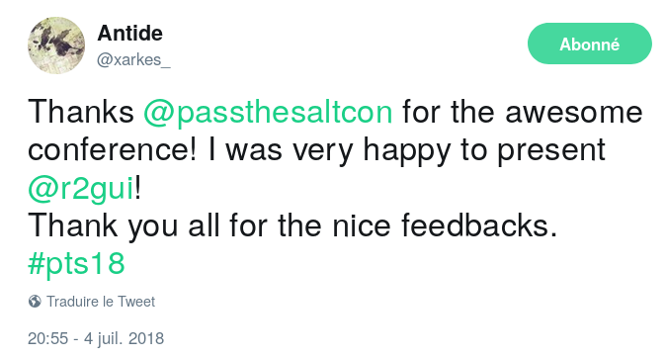
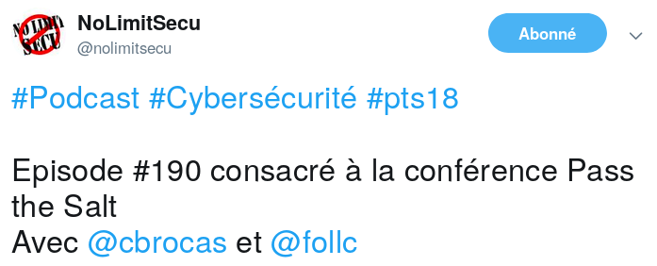
Media & feedback
« The event occurred smoothly in a very relaxed atmosphere, put it on your agenda for next year because this event is free (important to remind) but the quality of talks is high! »
https://blog.rootshell.be/2018/07/04/pass-salt-2018-wrap-day-3/

Slide 5

Why sponsor
Brand exposure: our brand strengthens its image with the participants present (hackers, professionals, researchers) or with those watching in streaming / replay.
Recruitment : your hiring process will be made more credible by your presence as a partner.
Strengthen your brand image inside the community by allowing :
  a free access to quality talks about Security and Free Software ;
  exchanges and collaborations between experts from these communities, passionate hackers but also professionals using Open Source Security solutions.

Slide 6
Sponsoring counterparts
Sponsoring level | Platinum | Gold | Silver | Associations
Donation | Min 3000€ | Min 2000€ | Min 1000€ | Min 500€
Presence on all media supports (press, web, on site) | Yes, under the “Platinum Sponsors” | Yes, under the « Gold Sponsors » mention | Yes, under the « Silver Sponsors » mention | Yes, under the « Associations » mention
Possibility to have a rollup/kakemono at room entrance | Yes | Yes | No | No
Pre-booked seats for the event | Yes (4) | Yes (2) | No | No
Possibility to have a booth (table + rollup/kakemono) | Yes | No | No | No
Invitations for the Speakers Dinner | Yes (2) | No | No | No

Slide 7

Sponsorship form
2019
Complete and send it to SPONSORING@PASS-THE-SALT.ORG
Name:
Company / association name:
Role in the company / association :
Address :
Email :
Website :
My company engages itself to sponsor 2019 Pass the SALT at the following level:
□ Platinum sponsor 3 000€ or more: ..............................€
□ Gold sponsor 2 000€ or more: ..............................€
□ Silver sponsor 1 000€ or more: ..............................€
□ Association sponsor 500€ or more: ..............................€
Bank transfer to :
IBAN FR7616798000010000065413623
BIC TRZOFR21XXX
Account name PASS THE SALT Association 12 PLACE DE LERME 33000 BORDEAUX FRANCE
Bank Treezor Rue Gallieni 150 92100 Boulogne-Billancourt France
Transfer label : « Sponsor PassTheSALT2019 »
City ............................… Date ....…….......… Signature and company stamp :

